Slide 1
Macroecons Tutorial 7
Group 7

Slide 2
Q1a. In Radford’s POW camp, how did cigarettes fulfil the three functions of money?
The three functions of money:
Medium of exchange in the purchase of goods and services.
Cigarettes served as a common mode of exchange - payment for the transaction of goods (food and clothing) and services (barbering) were done using cigarettes.
Unit of account. Money is the basic yardstick for measuring economic value.
Cigarettes had served as a unit of account – each cigarette represents a fixed value. They were used in the transaction of goods (prices were quoted using cigarettes) as it allowed easy comparison between the values of various goods and services in terms of the number of cigarettes each of them costed.
Store of value. Money is a way of holding wealth.
Cigarettes are easily storable in greater quantities as they are small yet durable. The monetary value of cigarettes could be maintained due to the limited supply as well as the demand for cigarettes (everybody smokes).
.

Slide 3
Q1b. Why do you think the prisoners used cigarettes as money, as opposed to other items of value such as squares of chocolates and pairs of boots?
Cigarettes are more suitable as money because it is durable, portable, divisible, homogenous(uniformity), and there was a limited supply of it.
Food items in general will rot and turn bad if not stored in the right conditions. In the prison, there was no suitable way to store chocolates. Therefore, though portable, divisible, and homogenous, squares of chocolate were not durable and hence not suitable to be used as money.
Pairs of boots were not suitable to be used as money due to the relatively high value - it is more difficult to banter for items that had lower value. They were also not portable in higher quantities.

Slide 4
Q1c. Do you think a nonsmoking prisoner would have been willing to accept cigarettes in exchange for a good or service in Radford's camp? Why or why not?
To a non-smoker, the value of the cigarette in terms of its utility is zero. Therefore, they would not want to exchange for cigarettes.
However, if cigarettes were unanimously recognised as the medium of transaction by the prisoner community, he would still be willing to accept cigarettes in return for a good or service. This is because cigarettes received could in turn be utilised to purchase other goods and services that provided him a level of utility/satisfaction.
The cigarettes now have monetary value to him. It is comparable to the paper money that we use today.

Slide 5
Q2. Redo the example of Gorgonzola in the text (see Tables 10.2 to 10.6), assuming that:
(1) Initially, the Gorgonzolan central bank puts 5,000,000 guilders into circulation
(2) Commercial banks desire to hold reserves of 20 percent of deposits.
As in the text, assume that the public holds no currency. Show the consolidated balance sheets of Gorgonzolan commercial banks for each of the following instances.

Slide 6
Q2a. After the initial deposits (compare to Table 10.2).
Q2b. After one round of loans (compare to Table 10.3).
Assets | Liabilities
Currency 5,000,000 | Deposits 5,000,000
Reserves: (20/100) * 5 000 000 = 1 000 000
Assets | Liabilities
Currency(=reserves) 1,000,000 | Deposits 5,000,000
Loans 4,000,000

Slide 7
Q2c. After the first redeposits of guilders (compare to Table 10.4).
Assuming public holds no cash and deposits all 4 000 000 back into the bank
Assets | Liabilities
Currency(=reserves) 5,000,000 | Deposits 9,000,000
Loans 4,000,000

Slide 8
Q2d. After two round of loans and redeposits (compare to Table 10.5).
Required Reserves: (20/100) * 9 000 000 = 1 800 000
2nd Round of Loans : 5,000,000 - 1,800,000 = 3,200,000
2nd Round of Deposits: 3,200,000
Assets | Liabilities
Currency(=reserves) 5,000,000 | Deposits 12,200,000
Loans 7,200,000

Slide 9
Q2d. What are the final value of or bank reserves, loans, deposits, and the money supply (compare to Table 10.6).
Final Reserves: 5,000,000
Bank Deposits = Bank Reserves / Desired RDR
= 5,000,000 / 0.20
= 25,000,000
Assets | Liabilities
Currency (=reserves) 5,000,000 | Deposits 25,000,000
Loans 20,000,000
Money Supply = Currency in Circulation + Deposit Balance held by public
= 25,000,000

Slide 10
Q3a. Bank reserves are 100, the public holds 200 in currency, and the desired reserve-deposit ratio is 0.25. Find deposits and the money supply.
Desired Reserve-Deposit Ratio(rdr) = Bank Reserves/Bank Deposits
0.25 = 100/Bank Deposits
Bank Deposits = 400
Money Supply(MS) = Currency in circulation(C) + Deposit balances held by public in commercial banks(D)
MS = 400 +200
MS = 600

Slide 11
Q3b. The money supply is 500, and currency held by the public equals bank reserves. The desired reserve-deposit ratio is 0.25. Find currency held by the public and bank reserves.
Bank Reserves/Bank Deposits = 0.25
Since Currency = Reserves,
C/D = 0.25
D = 4C
MS = D + C
500 = 4C + C
C = 100
Therefore, the currency held by public as well as the bank reserves amount to 100

Slide 12
Q3c. The money supply is 1,250, of which 250 is currency held by the public. Bank reserves are 100. Find the desired reserve-deposit ratio.
C + D = MS
250 + D = 1,250
D = 1,000
rdr = Bank Reserves/ Bank Deposits
rdr = 100/1000
rdr = 0.1

Slide 13
Q4. When a central bank increases bank reserves by $1, the money supply rises by more than $1. The amount of extra money created when the central bank increases bank reserves by $1 is called the money multiplier.
Explain why the money multiplier is generally > 1.
Theoretical:
Under a fractional reserve banking system, banks will keep a portion of reserves and lend the remaining reserves as loans to private citizens
Assuming these citizens prefer bank deposits to cash for making transaction, the same amount of reserves will be redeposited into banking system
Additional redeposition of reserves result in excess reserves where banks will undergo another round of loaning out and redeposition and thus, a further increase in the money supply where money is being ‘’created’’
Therefore, money multiplier is generally > 1 as an increase in bank reserves will lead to a multiplied increase of money supply due to the above cycle of loaning and redeposition

Slide 14
Q4a. In what case would it = 1?
Based on Money Multiplier = Bank Deposits / Bank Reserves formula, in order for money multiplier to = 1, where Bank Deposits = Bank Reserves
Meaning banks choose to hold all additional reserves as excess reserves and they do not loan them out this is also known as 100% reserve banking
Thus, no continued cycle of redeposition and loaning out which does not lead to a further increase in the money supply

Slide 15
Q4b. The initial money supply is $1000, of which $500 is currency held by the public.
The desired reserve-deposit ratio is 0.2. Find the increase in money supply associated with increases in bank reserves of $1, $5, $10. What is the money multiplier for this economy?
Money Supply = Currency in Circulation + Banking Deposits
Bank Deposits = Banking Reserves/Desired Reserve-Deposit Ratio
Initial Money Supply = $1000
Currency in Circulation = $500
Desired RDR = 0.2
Initial Bank Deposits = $1000 - $500 = $500
When Bank Reserves increase by $1,
Bank Deposits Increase by: $1/0.2 = $5
Hence, MS Increases by: $5
Thus, from the above, the money multiplier for this economy is 5.
When Bank Reserves increase by $5,
Bank Deposits Increase by: $5/0.2 = $25
Hence, MS Increases by: $25
When Bank Reserves increase by $10,
Bank Deposits Increase by: $10/0.2 = $50
Hence, MS Increases by: $50

Slide 16
Q4c. Find a general rule for calculating the money multiplier.
Based on Part 4b, Money Multiplier = Bank Deposits / Bank Reserves
Desired Reserve-Deposit Ratio = Bank Reserves / Bank Deposits
By rearranging the equation, Money Multiplier = 1 / Desired Reserve-Deposit Ratio

Slide 17
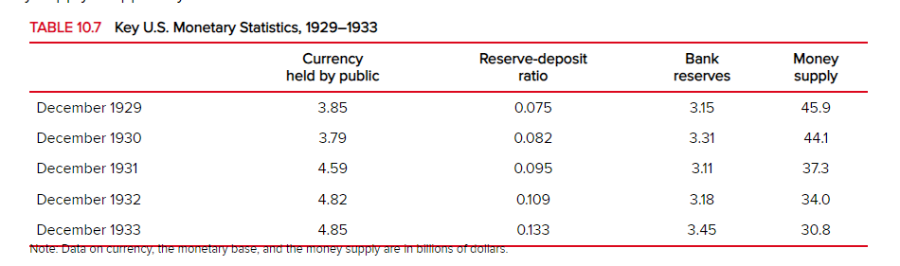
Q5. Refer to Table 10.7. Suppose that the Fed had decided to set the U.S. money supply in
December 1932 and in December 1933 at the same value as in December 1930. Assuming
that the values of currency held by the public and the reserve-deposit ratio had remained as
given in the table, by how much more should the Fed have increased bank reserves at each
of those dates to accomplish that objective?

Slide 18
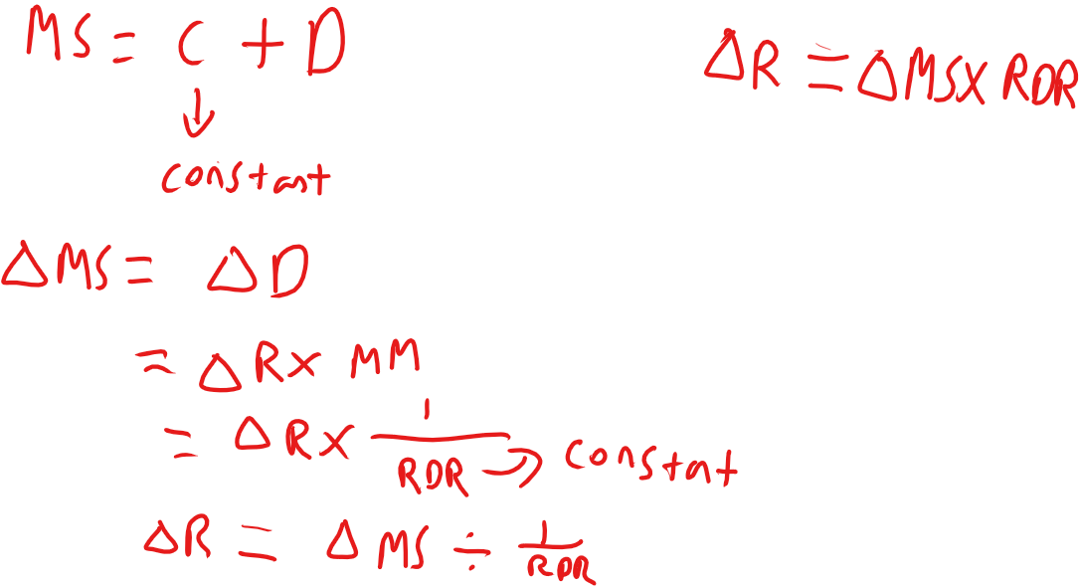
Q5.

Slide 19
Q5.
For 1932,
ΔMS=44.1-34.0
=10.1
RDR=0.109
ΔR=10.1 x 0.109
= 1.1009
For 1933,
ΔMS=44.1-30.8
=13.3
RDR=0.133
ΔR=13.3 x 0.133
= 1.7689

Slide 20
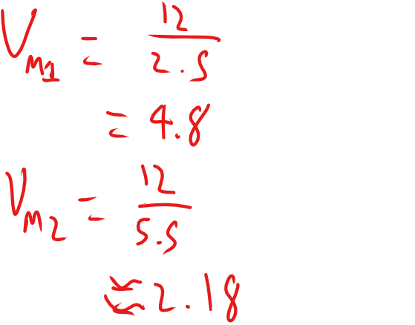

Q6.Consider a country in which real GDP is $9 trillion, nominal GDP is $12 trillion, M1 is $2.5
trillion, and M2 is $5.5 trillion.
A.Find velocity for M1 and for M2.

Slide 21
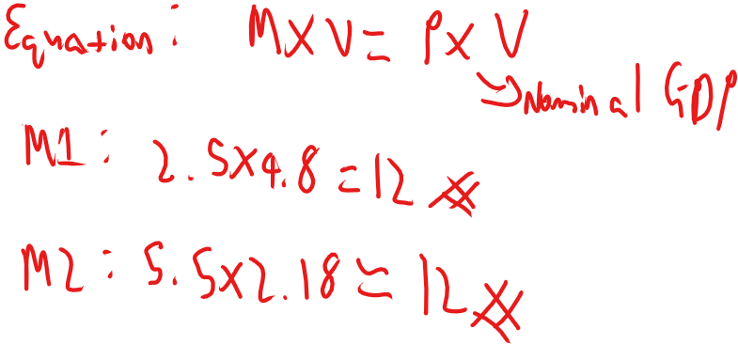
Q6. B.Show that the quantity equation holds for both M1 and M2.

Slide 22
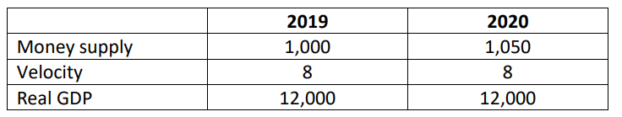
Q7.
Consider the following hypothetical data for 2019 and 2020:
Find the price level for 2019 and 2020. What is the rate of inflation between the two years?

Slide 23
Q7 A. Find the price level for 2019 and 2020. What is the rate of inflation between the two years?
The quantity equation states that money times velocity equals nominal GDP:
M x V = P x Y
Where, M= money supply
V= Velocity (measure of the speed at which
money circulates)
P= price level
Y= real GDP
Note: P x Y= nominal GDP

Slide 24
Q7 A. Find the price level for 2019 and 2020. What is the rate of inflation between the two years?
Using the quantity equation, M x V = P x Y :
2019: 1000 x 8 = P x 12000
P = 0.667 (3 sf)
2020: 1050 x 8 = P x 12 000
P = 0.700
Inflation btw 2019 and 2020 = (P₂₀₂₀ - P₂₀₁₉)/(P₂₀₁₉)
= (0.700-0.667)/(0.667) = 4.95% (3 sf)

Slide 25
Q7.
Consider the following hypothetical data for 2019 and 2020:
What is the rate of inflation between 2019 and 2020 if the money supply in 2020 is 1,100 instead of 1,050?
1100

Slide 26
Q7B. What is the rate of inflation between 2019 and 2020 if the money supply in 2020 is 1,100 instead of 1,050?
New quantity equation (2020):
1100 x 8 = 12000 x P
P = 0.733 (3 sf)
New inflation btw 2019 and 2020 = (P_{2020 new} - P₂₀₁₉)/(P₂₀₁₉)
= (0.733-0.667)/(0.667)
= 9.95% (3 sf)

Slide 27
Q7.
Consider the following hypothetical data for 2019 and 2020:
What is the rate of inflation between 2019 and 2020 if the money supply in 2020 is 1,100 and output in 2020 is 12,600?
1100
12600

Slide 28
Q7C. What is the rate of inflation between 2019 and 2020 if the money supply in 2020 is 1,100 and output in 2020 is 12,600?
New₂ quantity equation (2020):
1100 x 8 = 12600 x P
P = 0.698 (3 sf)
New₂ inflation btw 2019 and 2020 = (P_{2020 new 2} - P₂₀₁₉)/(P₂₀₁₉)
= (0.698-0.667)/(0.667)
= 4.71% (3 sf)

Slide 29
Thank you!

